Slide 1
ANNUAL EMPLOYEE TRAINING
HASBROUCK HEIGHTS
HEALTH SERVICES DEPARTMENT

Slide 2
Topics
Bloodborne Pathogens
Asthma
Epilepsy
Diabetes
Life-Threating Allergic Reactions
Epi-Pen
Head lice

Slide 3
What Are Bloodborne Pathogens?
They are germs in the blood that can make people sick.
Hepatitis B, Hepatitis C and HIV are examples of bloodborne pathogens (BBP).
These viruses can cause sickness.
They
Often cause no short-term symptoms
Can be passed on to others
Can lead to death

Slide 4
How Do Bloodborne Pathogens Enter The Body ?
At work the main ways that BBP’s can enter your body and make you sick include
Stick with a needle or sharp item that has infected blood on it
Infected blood or blood-containing material enters your eye, nose, or mouth or an opening in your skin

Slide 5
Exposure may not mean sickness
Even if you are exposed to a BBP, you may not get sick
Your risk of becoming sick is based on the amount of pathogen in the blood that entered your body and your body’s ability to fight the pathogen
There are treatments that can decrease your risk of sickness even after exposure

Slide 6
Make a PACT, Know How to Act
The best way to keep from becoming sick after exposure to BBP is to protect yourself from blood or blood-containing materials
If you come in contact with blood, there are certain actions you must take to try to stay safe

Slide 7
P.A.C.T
P PROTECT yourself from blood or blood- containing materials
A ACT quickly and safety
C CLEAN the area
T TELL your supervisor about the incident

Slide 8
Make a PACT: PROTECT
If you must help someone who is bleeding or if you must be around blood or blood-containing materials, there are things you should wear to protect yourself.
- These personal protective equipment may include
Gloves
Face shield
Goggles
Gown, apron or lab coat
Cap or hood

Slide 9
HANDWASHING
We use our hands to do many things, so they are the most likely areas to be exposed to blood
This makes washing your hands with soap and large amounts of water the single most effective form of protection for you
If you wash your hands correctly after contact with blood, you greatly reduce your chance of becoming sick or spreading germs to others

Slide 10
Make a PACT: ACT
If blood materials enter your eye, nose or mouth or an opening in your skin, you must act quickly to lessen the chance that you will become sick
Follow these steps if you are exposed
If you are wearing gloves, take them off
Immediately wash your hands, and any skin that came into contact with blood, very well with soap and large amounts of water
If it splashed in your eyes, nose or inside of your mouth, rinse these areas with lots of water
Tell your supervisor

Slide 11
Disposing of Sharps
Sharps are needles or other sharp items that may have come in contact with blood
These might include devices that people with diabetes may use to give themselves medicine
It is best to dispose of sharps in a sharps disposal container
Do not try to recap an exposed needle

Slide 12
Make a PACT: CLEAN
It is critical that you quickly and completely clean up any blood or blood-containing materials to limit the chance of your coworkers being exposed to BBP
Spills can often be cleaned simply with a disinfectant cleaner

Slide 13
CLEAN
When cleaning up a spill
You must
Put on appropriate personal protective equipment
Use absorbent materials such as paper towels to wipe up large amounts of blood
Use a surface disinfectant cleaner to clean any contaminated work surface
Dispose of cleaning materials and any personal protective equipment in the appropriate waste containers

Slide 14
Make a PACT: TELL
It is very important that you report any exposure to blood or blood-containing materials
These reports help you get treatment and help your employer identify and reduce causes of exposure
Your employer may need to complete Occupational Safety and Health Administration (OSHA) Form

Slide 15
OSHA REGULATIONS
The Occupational Exposure to Bloodborne Pathogens Standard is published by OSHA
This standard defines the rules employers must follow to protect employees who may have a reasonable chance of being exposed to blood or materials in their jobs

Slide 16
Purpose
To comply with DOE health services policy and procedural requirement 6A:16-2.1
To assist staff in the recognizing of medical emergencies as it relates to asthma, diabetes, seizure disorders and anaphylaxis.
To obtain rapid medical response to the student who has a medical emergency.
To remind staff to refer to the general first aid guidelines provided each year by the school nurse

Slide 17
ASTHMA
It is a long term (chronic) lung disease
It is triggered by indoor and outdoor allergens and irritants
It can’t be cured ONLY controlled
Warning Signs of an Asthma Episode
Cough
Shortness of breath
Mild wheeze
Tightness of the chest

Slide 18
ASTHMA
Never send a student to the nurse’s office alone
Emergency Care Plan
Know your students – see the nurse to review your class list

Slide 19
EPILEPSY/SEIZURES
Epilepsy is a chronic neurological disorder characterized by a tendency to have recurrent seizures
Epilepsy is also known as a “seizure disorder”
There are different types of seizures
Seizure symptoms depend on where in the brain the excessive electrical activity occurs and how much of the brain is affected during the seizure
Seizures are temporary and episodic

Slide 20
SEIZURE TYPES
Generalized Seizures
Involve the whole brain
Common types include absence and tonic-clonic
Symptoms may include convulsions, staring, muscle spasms and falls
Partial Seizures
Involve only part of the brain
Common types include simple partial and complex partial
Symptoms relate to the part of the brain effected
Auras:
- Some students will have a definite sign that a seizure is about to happen
An odd taste or smell, a feeling of fear, a visual or auditory experience or a tingling sensation
An aura may allow the student to prepare for the oncoming seizure and warn others

Slide 21
First Aid for Seizures
Stay calm and track the time / send for help
Check for epilepsy or seizure medical alert ID
Protect the student from possible hazard (chairs, desks, tables, sharp objects)
Turn the student on their side (to prevent blockage of the airway from tongue, salvia or vomit)
Cushion their head
After the seizure, remain with the student until awareness of surroundings if fully regained
Provide emotional support
Document seizure activity
DO NOT place anything in their mouth
DO NOT hold them down
DO NOT attempt to give oral medications, food or drinks

Slide 22
DIABETES
TYPE 1
Is usually diagnosed in children and young adults
The body does not produce insulin
Type 2
Most common form of diabetes and either the body does not produce enough insulin or the cells ignore the insulin
The student who does not produce insulin needs to give themselves an insulin injection: either by a needle/syringe, prefilled insulin pen dose, or entering a dose given through an insulin pump (looks like a pager, so don’t take it away! They are not text messaging!)

Slide 23
Hypoglycemia: Possible Signs & Symptoms
Mild Symptoms
Hunger Sleepiness
Shakiness Change in Behavior
Weakness Sweating
Paleness Anxiety
Blurry Vision Dilated Pupils
Increased heart rate / palpitations
MODERATE TO SERVE SYMPTOMS
Yawning, Confusion, Irritability, Frustration, Restlessness, Extreme tiredness, fatigue, Dazed Appearance
Inability to swallow, Sudden Crying, Unconsciousness, Coma, Seizures

Slide 24
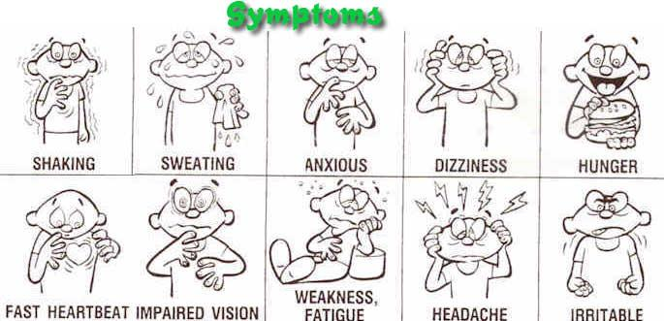

Slide 25
What to do if your student shows symptoms of hypoglycemia (low blood sugar)
Notify the nurse / never send a student alone
If symptoms of low blood sugar and conscious and able to swallow give:
Glucose tablets 3 to 4 OR Glucose gel
If not available give:
Cake icing 4-5 tsp.
Orange or Apple Juice: ¾-1 cup
Table Sugar: 4-5 tsp.
Regular Soda: 5-6 OZ or Milk: 8-10 oz.
Life Savers: 5-7

Slide 26
GLUCAGON
Glucagon is a medication administered to people with diabetes when their blood sugar level drops dangerously low and the person is exhibiting symptoms that may lead to brain injury and death
In an emergency, glucagon may be administered by non-medical staff (Delegate) when the nurse is not available (just like the epi-pen)
Training is needed for the delegate to administer glucagon in an emergency
Parents must provide written consent for the emergency administration of glucagon

Slide 27
GLUCAGON

Slide 28
Life-Threatening Allergic Reactions
A person can have a severe allergic reaction resulting in death!
Common allergens include, but limited to, bees/wasps, foods like peanuts, soy, tree nuts, milk, and items that contain latex.
SIGNS OF AN ALLERGIC REACTION INCLUDE:
MOUTH/FACE Itching, swelling of lips, tongue, or mouth. Swelling of face, area around eyes.
THROAT Itching and/or a sense of tightness in the throat, hoarseness, hacking cough.
SKIN Hives, itchy rash, and/or swelling about the face or extremities, cold/clammy skin.
GUT Nausea, abdominal cramps, vomiting, and/or diarrhea
LUNG Shortness of breath, repetitive coughing, and/or wheezing
HEART Thread like or weak pulse, passing out
THE SEVERITY OF SYMPTOMS CAN QUICKLY CHANGE!

Slide 29
Treatment for life threatening allergy…. ANAPHYLAXSIS
Do not hesitate to have the student administer their own epinephrine and call 911
If you are trained / Epi-Pen Delegate you can administer the epinephrine
We need volunteer delegates for field trips, after-school programs, etc.
Need to be trained by the school nurse
( CPR certified)

Slide 30
HEAD LICE
Head lice / Louse is a parasite, which means it feeds off of other living thing.
Lice (the word for more than one louse) are about the size of a sesame seed,
They come is different colors;
silver, yellow, brown, tan, black
They need to suck a tiny bit of blood to survive
Only live on humans – NO dogs or cats
They sometimes live on people’s heads and lay
eggs in the hair, back of neck/behind the ears are
the favorite spots
They do not like light or oily/greasy hair
They do NOT carry any diseases

Slide 31
HEAD LICE
A louse lays tiny, oval eggs called nits
They are yellow, tan or brown before they hatch
Lice can survive up to 30days on a person’s head and can lay 7-10 eggs a day
After the lice hatches, nits appear clear or white
They look like dandruff flakes but they can’t be shaken off
The nits/eggs are a “perfect tear drop shape” and stick to the hair like glue
The lice mature within 1-2 weeks and begin feeding and attaching their tiny claws to the hair shaft

Slide 32
HEAD LICE
Lice can not jump or fly – only craw since they do not have wings
Lice can live off the human head for up to 2 DAYS
They spread when people’s heads touch or
When they share helmets, hats, clothing, combs, brushes, headbands, barrettes, hair scrunchies, sheets, blankets, pillows, sleeping bags
Vacation, hotels, airplanes, movie theaters
Clothes shopping – trying on hats or clothes

Slide 33
Nits v Dandruff
If you think you see a nit/egg
Egg Nit
will NOT move; it’s stuck on the hair like glue
Run your finger over
It will not come off if you try to blow it off
You need to pull it off the hair shaft
It will be that perfect teardrop shape
Dandruff, hair cast will come off the hair very easy
You can blow it off the hair shaft
It is not perfect in shape

Slide 34
Not only treat the head – you must treat the whole environment
Head lice can live for only 1-2 days off a person’s head
You must wash all your bedding, clothes, hats, hair scrunchies, stuffed animals
Vacuuming the carpets, upholstery, and cars will take care of any lice that feel off before treatment (last up too 2 Days)
Any thing that you can’t wash
Put in an airtight bag for 10days – in the garage
DO NOT SHARE

Slide 35
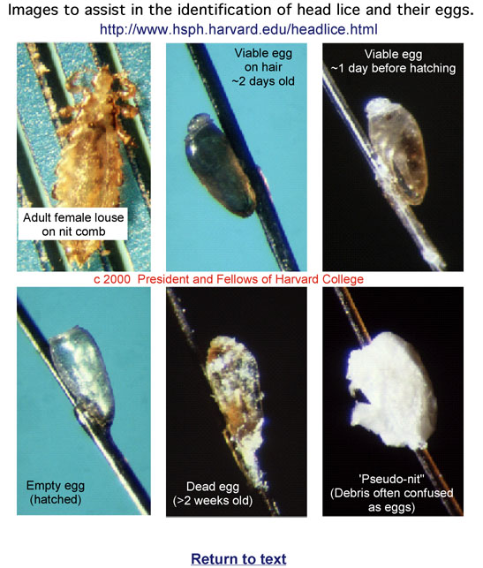

Slide 37
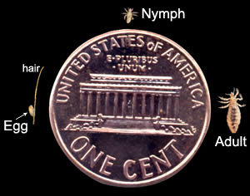

Slide 38
Where to get more information
The Pediatric/Adult Asthma Coalition of New Jersey
http://www.pacnj.org
School Asthma Allergy
http://www.schoolasthmaallergy.com
Epilepsy Foundation
http://www.epilepsyfoundation.org
PADRE Foundation (teens with diabetes)
http://www.padrefoundation.org
The Food Allergy and Anaphylaxis Network
http://www.foodallergy.org
American Diabetes Association
State of New Jersey, Department of Education

Slide 39
RESOURCES
www.osha.gov
www.cdc.gov/ncidod/dhqp/bp.html
www.onlineaha.org
www.kidshealth.org
American Heart Association

